Slide 1
Chipyard:
Integrated RISC-V SoC Design, Simulation, Implementation Environment
Borivoje Nikolić
University of California, Berkeley
bora@eecs.berkeley.edu

Slide 2
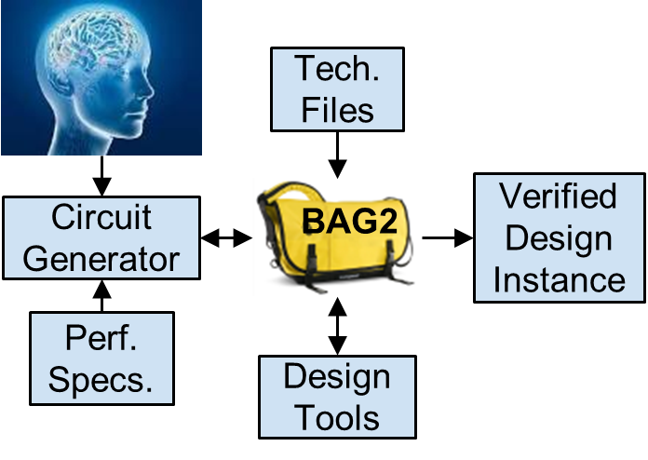
Generators Enable Specialization, Lower Design Cost
Digital: Chisel3
CHISEL: Constructing Hardware In Scala Embedded Language
Open-source hardware construction language
Software library whose classes represent hardware primitives
Methods connect the classes together
So executing the software constructs a graph representing the RTL
Compiles to FIRRTL
Emits Verilog + collaterals
v.3.4 is current
CHISEL/FIRRTL have graduated!
Moved to CHIPS Alliance
J. Bachrach, et al, DAC 2012
Analog: BAG2 / BAG3
Open-source Python-based framework allowing executable specification of design procedure
Includes family of layout APIs enabling process-portable but designer-controlled analog layout generators
J. Crossley, et al, DAC 2013
E. Chang, et al, CICC 2018

Slide 3

Berkeley RISC-V ISA
www.riscv.org
An open, license-free ISA
Runs GCC, LLVM, Linux distributions, glibc, …
RV32, RV64, and RV128 variants for 32b, 64b, and 128b address spaces
Base ISA only ~40 integer instructions
Extensions provide full general-purpose ISA, including IEEE-754/2008 floating-point
Designed for extension, customization
Developed at UC Berkeley, maintained by RISC-V Foundation
Most of cost of chip development is in software, so want to make sure software is reused across many chip designs
Many research and commercial cores offered
Pulpino
Rocket
Rocket is an example of a generator written in Chisel

Slide 4
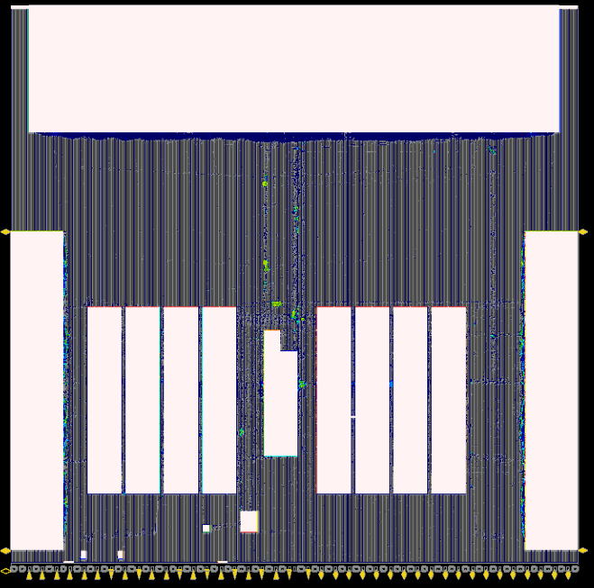
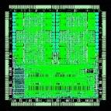
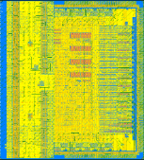
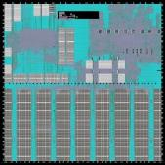
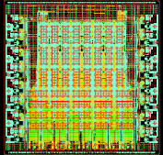
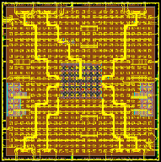
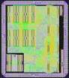
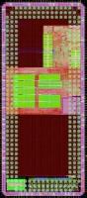
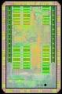
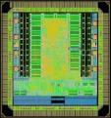
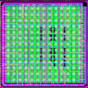
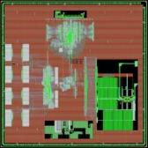
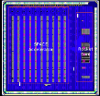
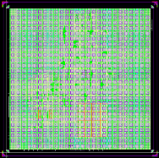
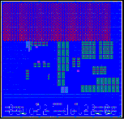
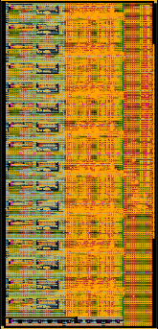
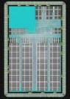
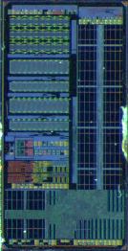
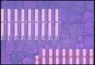
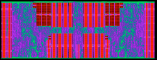
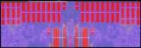
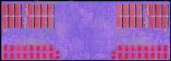
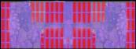
Chisel+BAG-Generated RISC-V Chips
Verilog
Chisel
Chisel2
Chisel3+BAG2
BAG
ADCS
EAGLEX
Raven-2
EAGLE
Hurricane-1
Hurricane-2
CraftP1
Raven-1
Raven-3
Raven-4
FADER
May
Apr
Aug
Feb
Jul
Sep
Mar
Nov
Mar
Apr
Jul
Mar
May
Jun
Mar
2011
2012
2013
2014
2015
2016
2017
2018
2019
2020
EOS18
BEAGLE
EOS14
EOS16
EOS20
CRAFT-0
AI
SWERVE
GPS
FFT2
EOS22
EOS24
HYDRA
Raven, Hurricane: ST 28nm FDSOI, SWERVE: TSMC 28nm EOS: IBM 45nm SOI, CRAFT: 16nm TSMC, Beagle, Hydra: Intel 22FFL

Slide 5
We Have Generated a Lot of Stuff!
Many open source components:
Chisel
BOOM Core
Diplomacy
FireSim
FIRRTL
Rocket Core
TileLink
Configuration System
RISC-V
Caches
Accelerators
Peripherals
HAMMER
BAG
Goal: Make it easy for small teams to design, integrate, simulate, validate workload performance and tape-out a custom SoC

Slide 6
Chipyard
Chipyard
Tooling
Rocket Chip
Flows
Chisel
Generators
Diplomacy
FireSim
Rocket Core
BOOM Core
FIRRTL
Configuration System
HAMMER
Accelerators
TileLink
RISC-V
Software RTL Simulation
Caches
Peripherals
BAG
BAG Modules

Slide 7
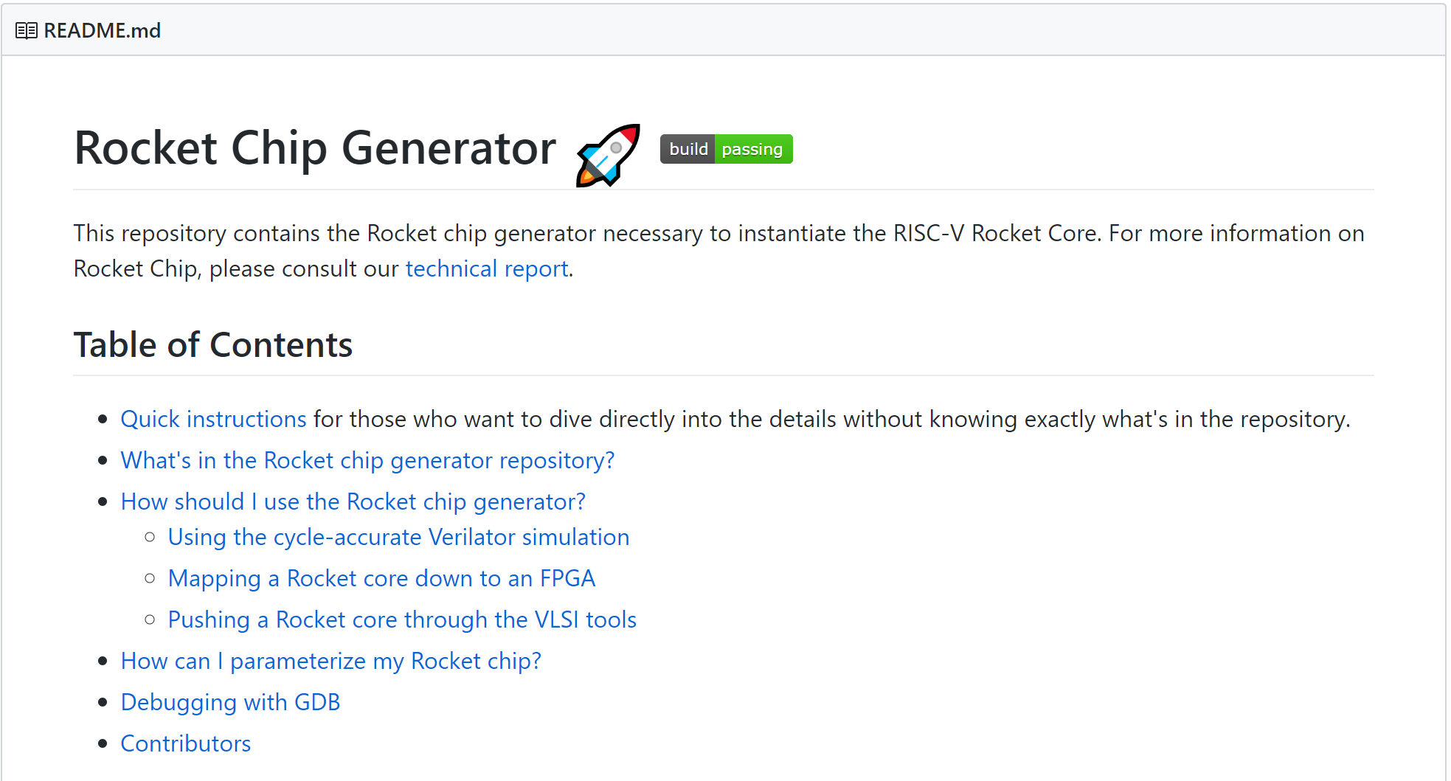
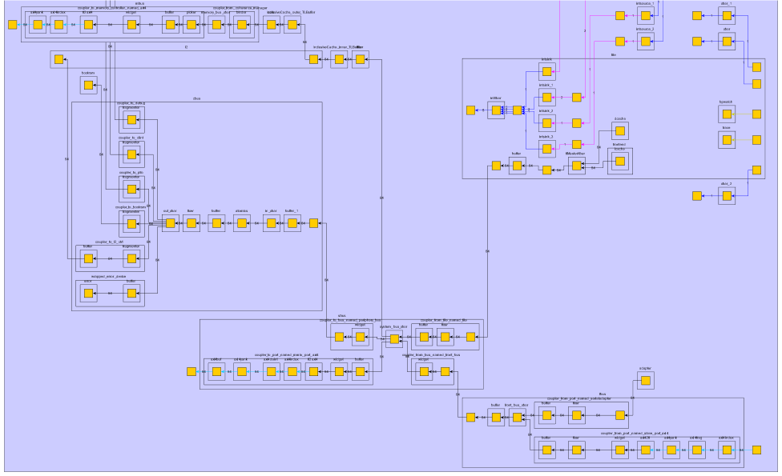
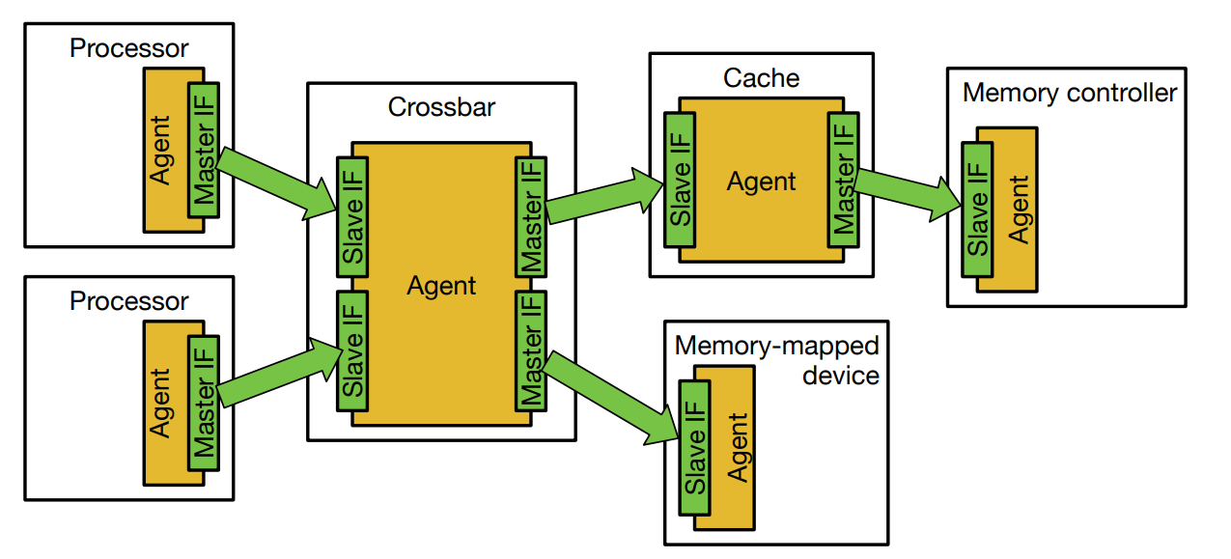
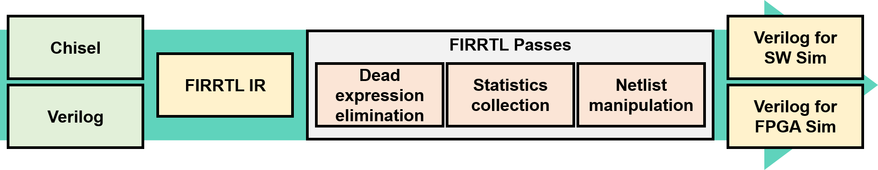
Foundational Components
Rocket Chip SoC generators
Parameterization system
Component composability
SoC system integration
TileLink/Diplomacy interconnect
Chisel / FIRRTL
Productivity through object-oriented/functional meta-programming for HDL
IR transforms to enable single-source multi-platform.

Slide 8
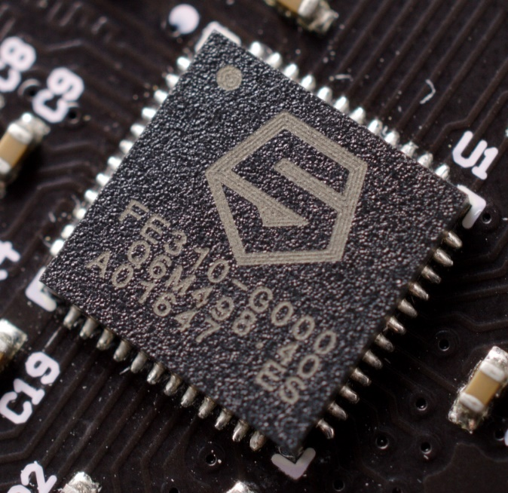
What is Rocket Chip?
A highly parameterizable SoC generator
Replace default Rocket core w/ your own core
Add your own coprocessor
Add your own SoC IP to uncore
A library of reusable SoC components
Memory protocol converters
Arbiters and Crossbar generators
Clock-crossings and asynchronous queues
The largest open-source Chisel codebase
Scala allows advanced generator features
Developed at Berkeley, now maintained by many
SiFive, CHIPS Alliance, Berkeley
In industry: SiFive Freedom E310

Slide 9
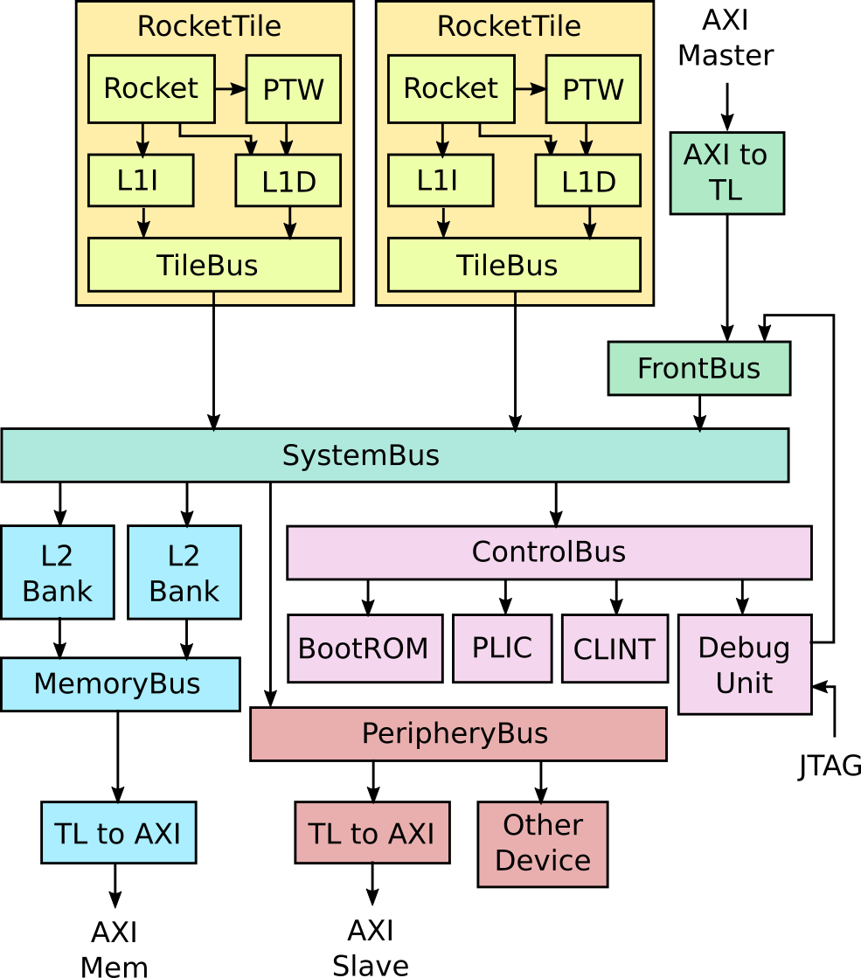
Structure of a Rocket Chip SoC
Tiles: unit of replication for a core
CPU (Rocket, BOOM, Ariane/CVA6)
L1 Caches
Page-table walker
L2 banks:
Receive memory requests
FrontBus:
Connects to DMA devices
ControlBus:
Connects to core-complex devices
PeripheryBus:
Connects to other devices
SystemBus:
Ties everything together

Slide 10
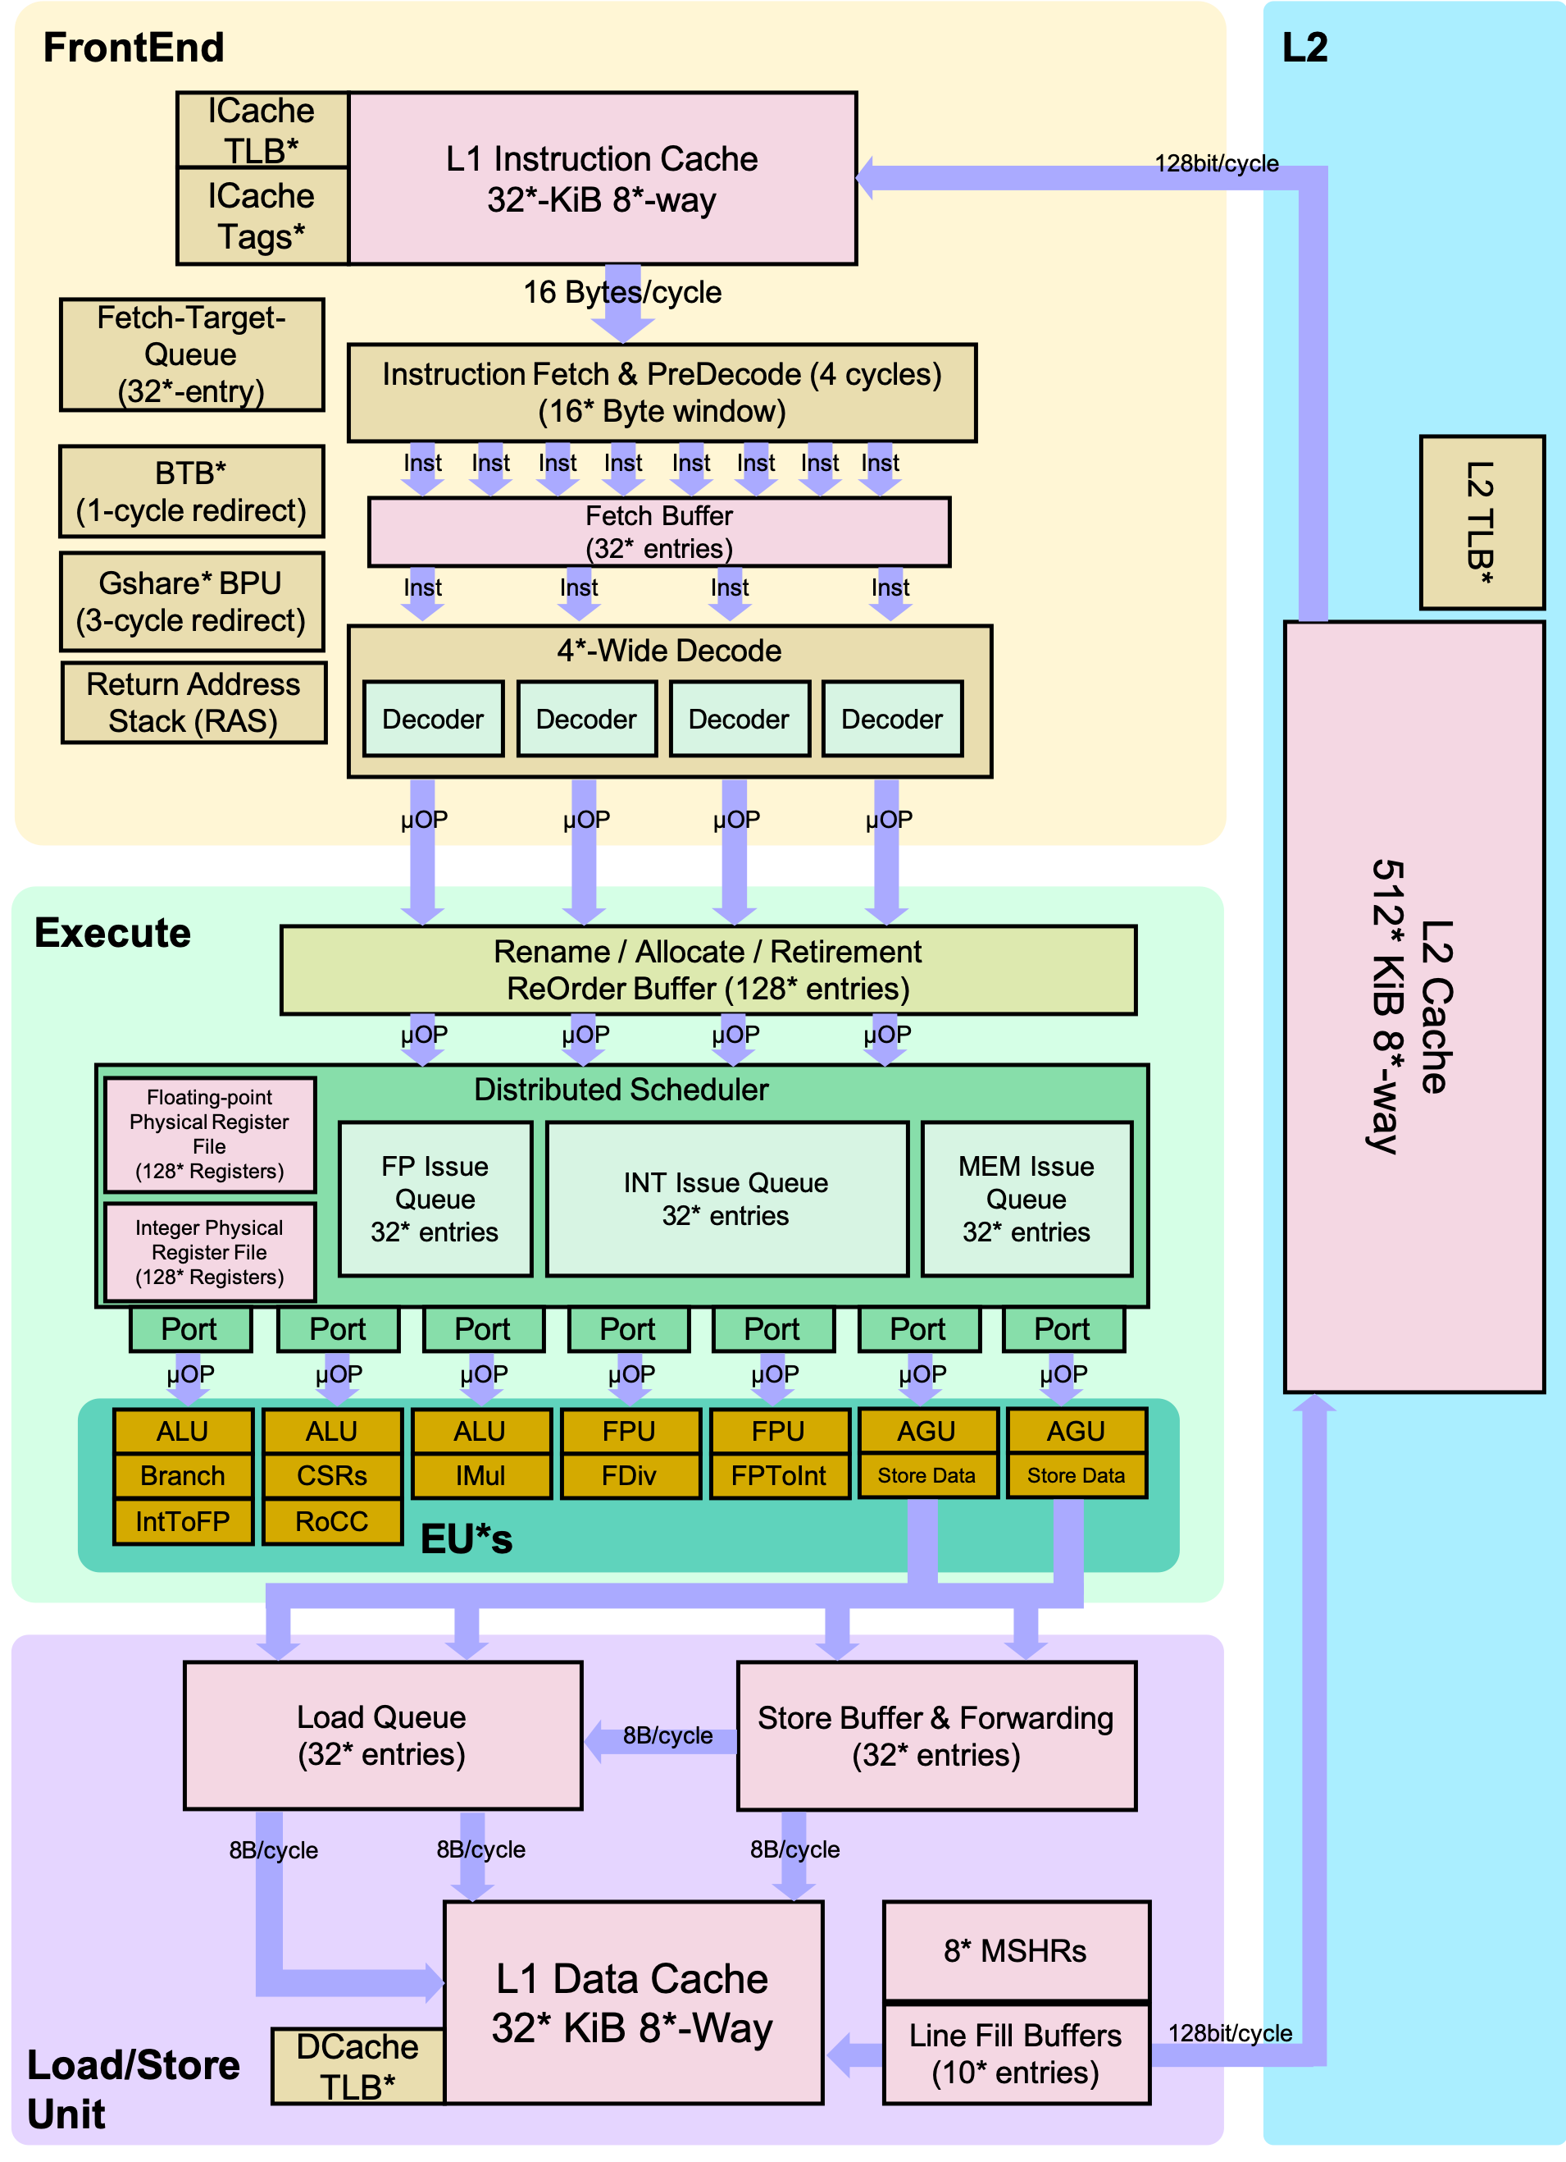
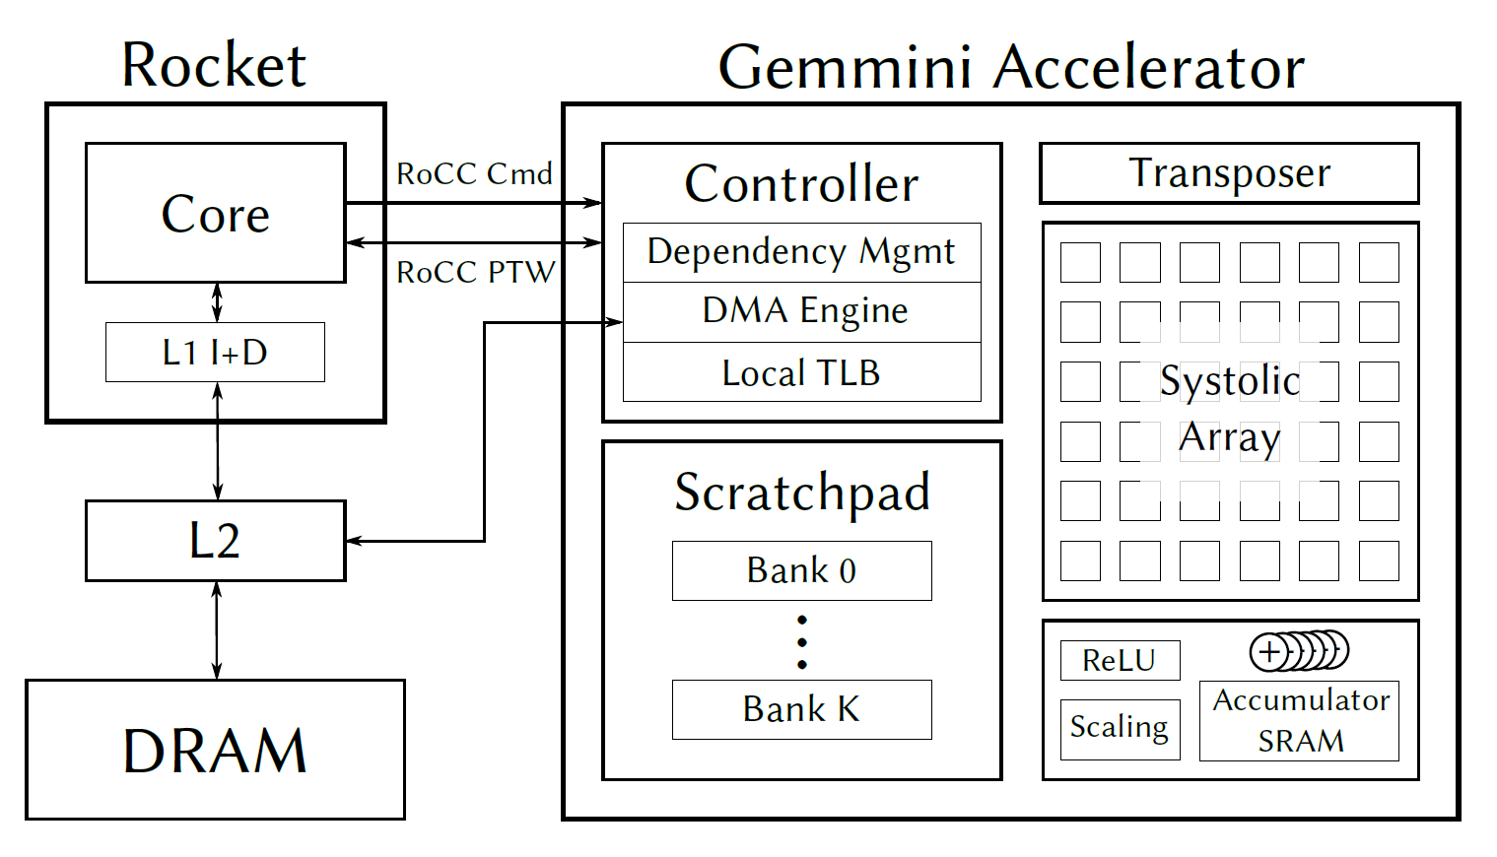
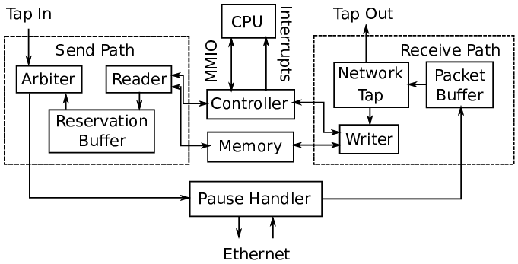
Generators Integration
Cores
Rocket, BOOM
Sodor
Ariane (CVA6)
Accelerators
Hwacha
Gemmini
Educational: SHA3
NVDLA
Memory System
SiFive’s Last-Level Cache
Peripherals
Icenet
SiFive Blocks
Testchip IP

Slide 11
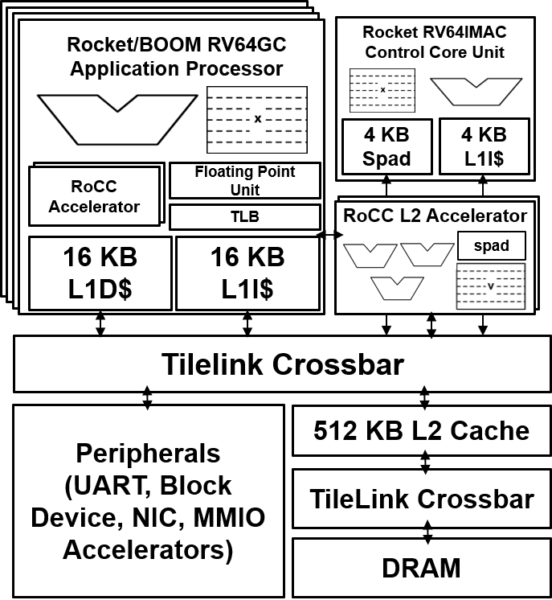
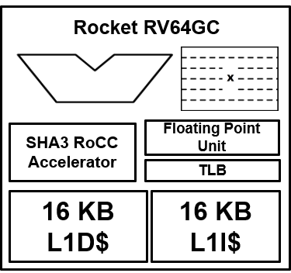
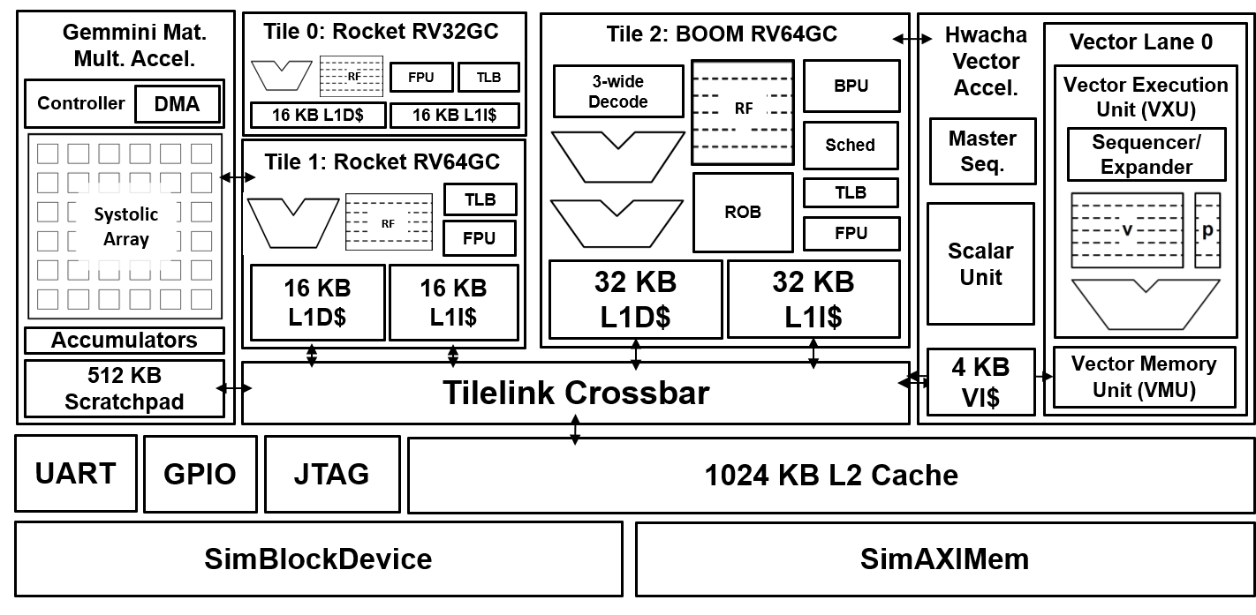
Customization
Cores and controllers: Intra-core Rocket/BOOM configurations
Control core / PMU as an example
Simple RoCC accelerators
SHA3 as a demo
Complex RoCC accelerators
Hwacha and Gemmini as examples
MMIO Tilelink accelerators
Peripherals

Slide 12
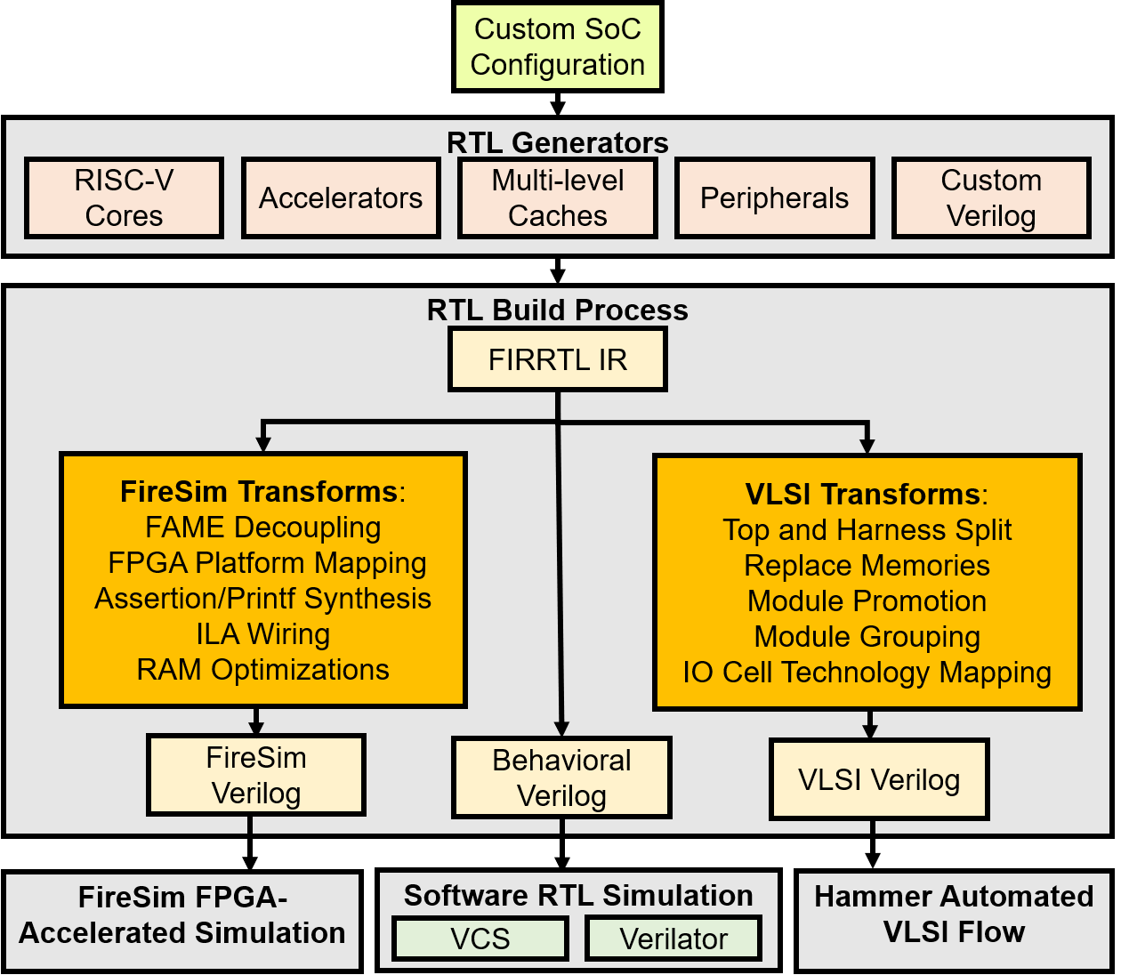
Simulation/Implementation Targets
Custom hardware design is not just about generated IP blocks!
Different collaterals for different simulation or implementation targets
Design cycle RTL simulation
Verification / Validation
VLSI flow
FPGA prototyping

Slide 13
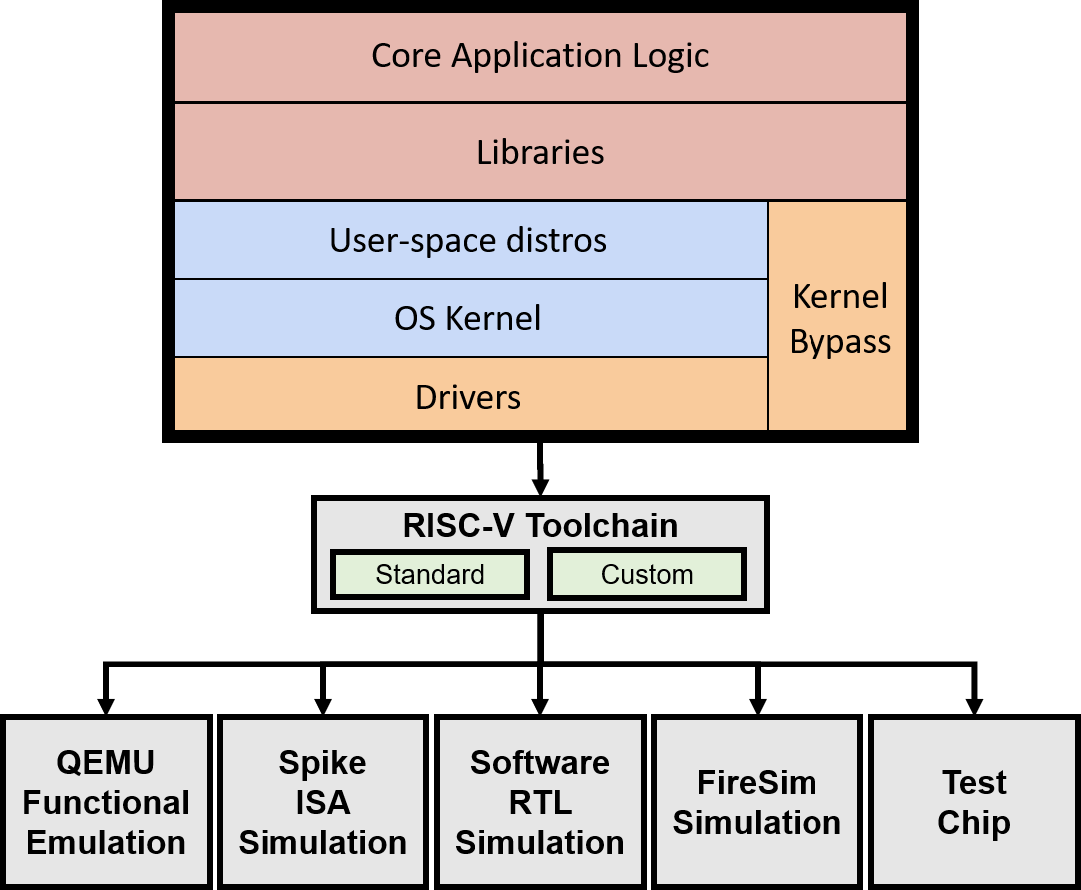
Software
Compatible standard RISC-V Tools versions
ESP-Tools as a non-standard equivalent SW tools package with custom accelerator extensions (Hwacha, Gemmini)
Libgloss based bare-metal tests
FireMarshal workload and Linux distro management
Notes:
While basic RISC-V software has stabilized and been upstream (mostly the GNU toolchain, and major components of LLVM),it is still sometime requires to use the newest versions of the tools, and find compatible toolchains (for example, in the content of new standard extension like the vector extensions). Furthermore, specific accelerator require modification to the software toolchains (binutils) or the ISA simulator (spike). Chipyard maintains the old “riscv-tools” model to provide a set of compatible software tools. It uses a parallel esp-tools set for a custom toolchain for the non-standard extensions and accelerators available in chipyard.

Slide 14
Chipyard 1.4 Updates

Slide 15
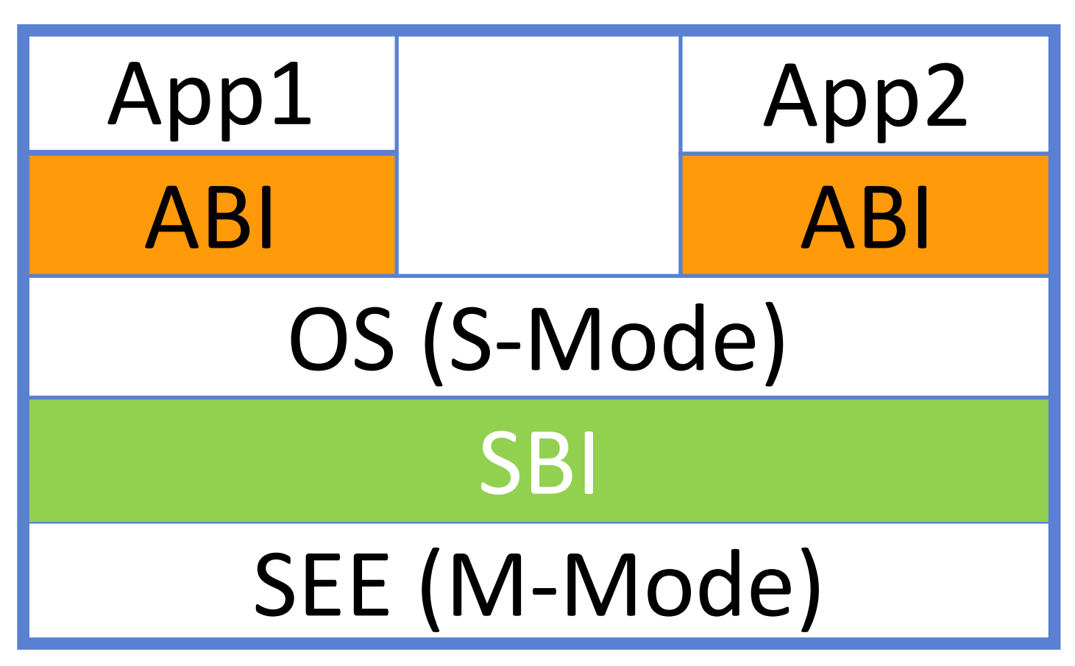
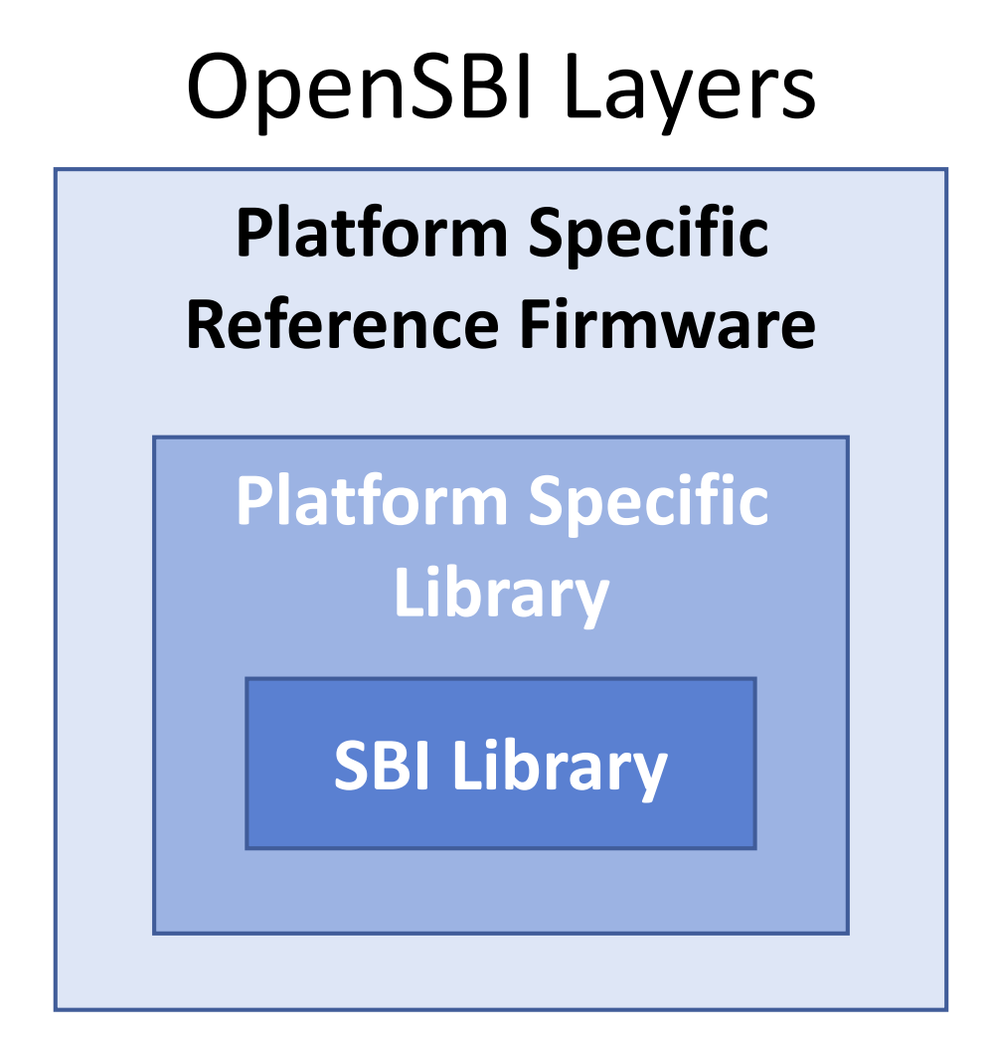
OpenSBI Integration
OpenSBI – Open-source implementation of RISC-V Supervisor Binary Interface (SBI) specifications.
PMP Support, Missing CSR emulation, Misaligned load/store
Flexible, layered approach
OpenSBI Integration - OpenSBI as the default bootloader in Chipyard
Helps to avoid SBI implementation fragmentation
Broader community support than bbl
bbl remains as an option for legacy workloads
Western Digital: https://riscv.org/wp-content/uploads/2019/06/13.30-RISCV_OpenSBI_Deep_Dive_v5.pdf
Notes:
OpenSBI's appeal over bbl is the additional flexibility:
1. It follows a Linux-like device model that makes writing drivers more modular.
2. Platform-specific code can be added through hooks.
3. It can be used as a static library in other bootloaders/firmware (as can bbl but which is less well-documented).

Slide 16
HarnessBinders
IOBinders: generalized abstraction for IO interfaces from the chip perspective
IOCells for test-chip tapeout
Bridges for FireSim simulations
Passthrough wires for digital software RTL simulation
HarnessBinders: generalized abstraction for IO interfaces from the test environment perspective
SystemVerilog harness for software RTL simulation
FireSim Harness with Golden Gate Passes
FPGA “shell” for local FPGA prototyping
FMC / host FPGA softcore interface for FPGA-teathered test-chip bringup
Help converge pre-silicon and post-silicon testing environments

Slide 17
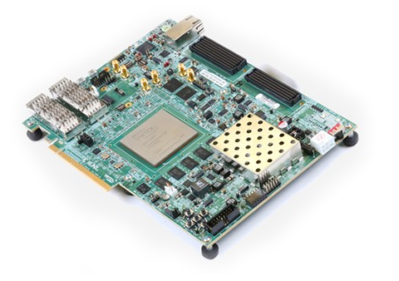
Local FPGA Prototyping
FPGA prototyping vs. FPGA simulation/emulation
Initial support for VCU118 and Arty-7
Based on SiFive FPGA-shells
Enables expansion to additional FPGAs supported by fpga-shells
HarnessBinders
Can be used for test-chip bringup
Testing using SonicBOOM FPGA host
Future work includes PCIe-based interface and FireSim support
Notes:
Highlight Abe’s beagle demo uses this.

Slide 18
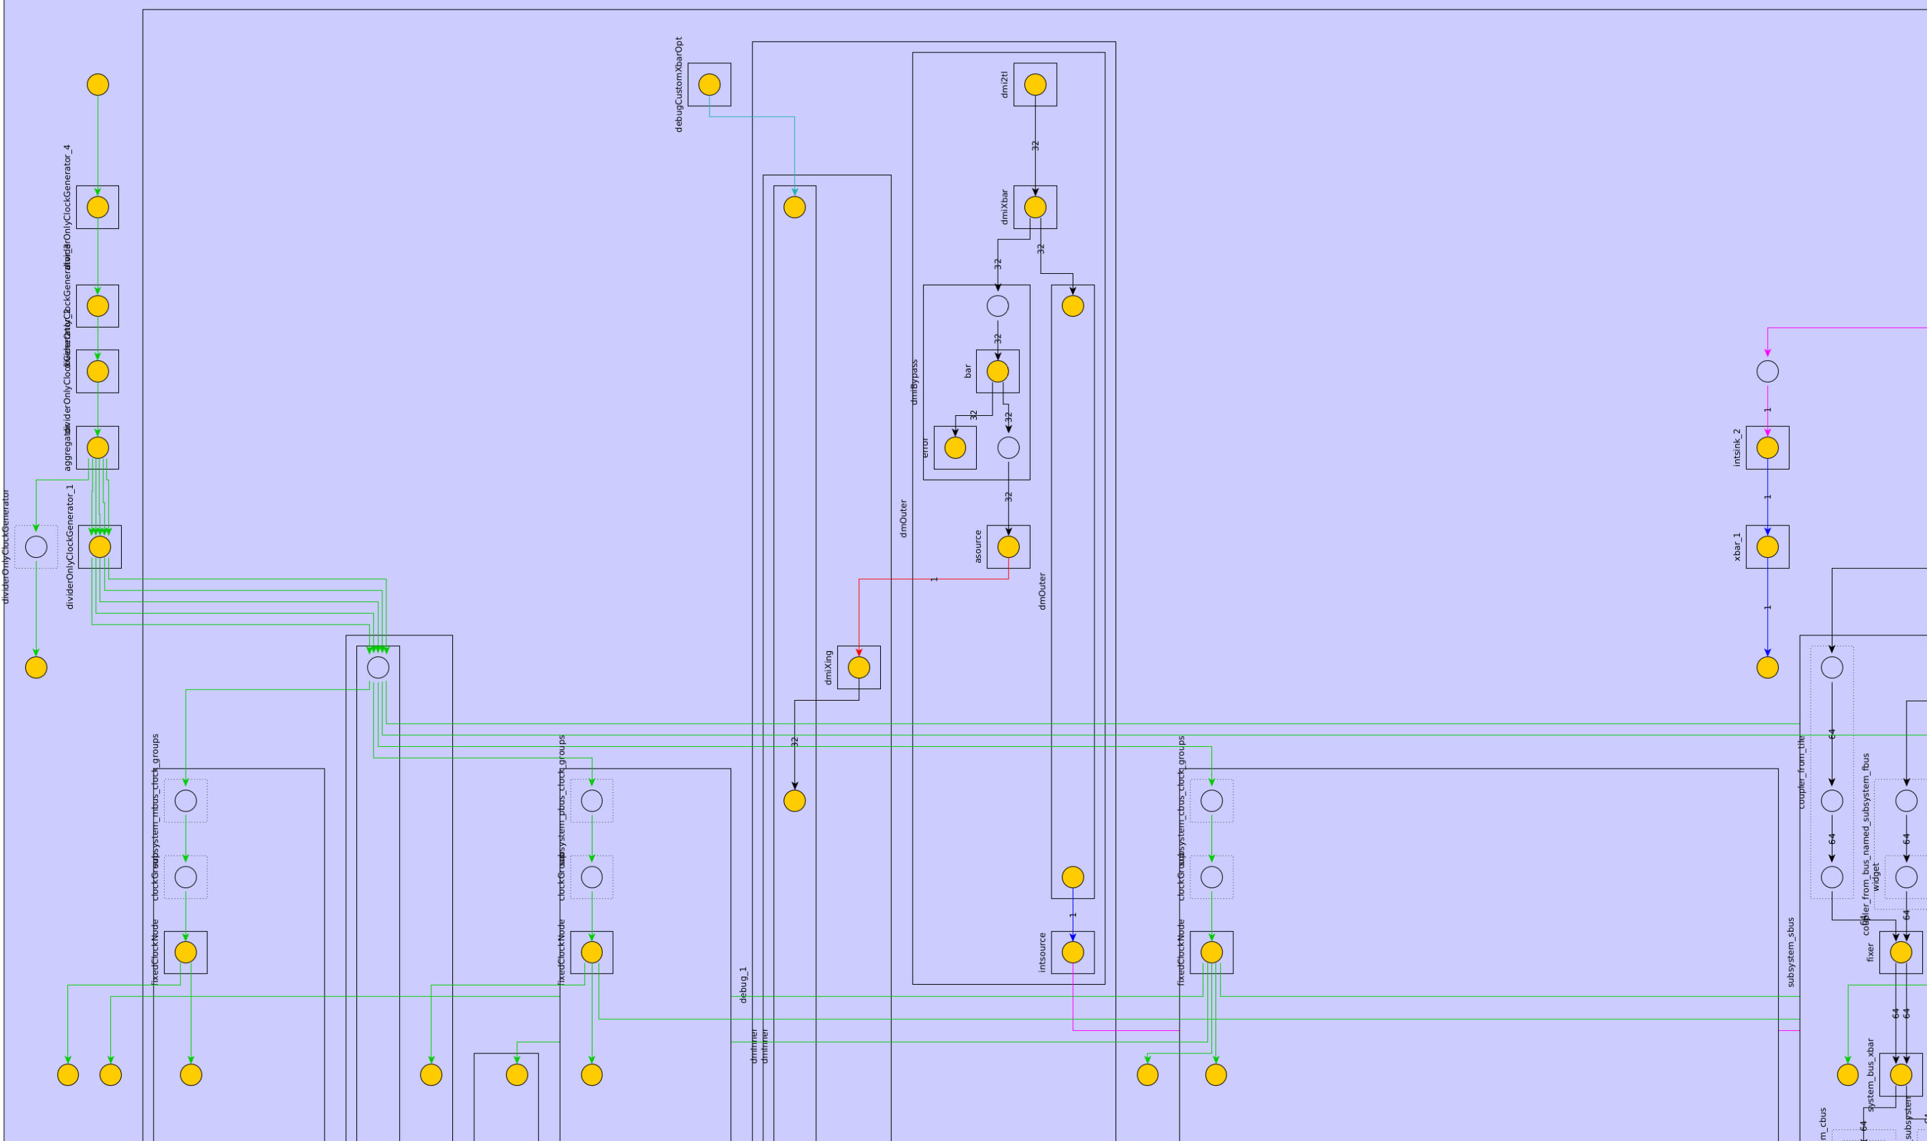
MultiClock Support
Diplomatic clocking
Multiclock config fragments
Bus frequency specification
Crossing specification
Divide-only PLL model multiclock simulation harness (FireSim, VCS, Verilator)
Automatically compute highest common frequency
class MulticlockRocketConfig extends Config(
new freechips.rocketchip.subsystem.WithNBigCores(1) ++
new chipyard.config.WithTileFrequency(1600.0) ++
new chipyard.config.WithSystemBusFrequency(800.0) ++
new chipyard.config.WithMemoryBusFrequency(1000.0) ++
new chipyard.config.WithPeripheryBusFrequency(100) ++
new chipyard.config.WithSystemBusFrequencyAsDefault ++
new chipyard.config.WithCbusToPbusCrossingType(AsynchronousCrossing()) ++
new chipyard.config.WithSbusToMbusCrossingType(AsynchronousCrossing()) ++
new freechips.rocketchip.subsystem.WithRationalRocketTiles ++
new testchipip.WithAsynchronousSerialSlaveCrossing ++
new chipyard.config.AbstractConfig)

Slide 19
Unified Generator Improvements
Use Chipyard configs in FireSim build recipes
No need to duplicate configurations within the FireChip environment
Override default UART baudrate in FireChip
Smoother experience when adjusting peripheral frequency
[firesim-boom-singlecore-nic-l2-llc4mb-ddr3]
DESIGN=FireSim
TARGET_CONFIG=WithNIC_DDR3FRFCFSLLC4MB_WithDefaultFireSimBridges_
WithFireSimConfigTweaks_chipyard.LargeBoomConfig
PLATFORM_CONFIG=F65MHz_BaseF1Config
instancetype=z1d.2xlarge
deploytriplet=None

Slide 20
Hammer: VLSI Flow
Improved Makefile-based Hammer integration with Chipyard
“single-click” gate-level simulation for RISC-V binaries
“single-click” full-chip simulation-based power estimation
OpenRoad nangate45 Hammer backend
Skywater 130 support in progress
Improved VLSI flow documentation
make CONFIG=… BINARY=…
RISC-V Binary
Chipyard-based SoC Config
Synthesis
Place-and-Route
Gate-level Simulation
Power Estimation

Slide 21
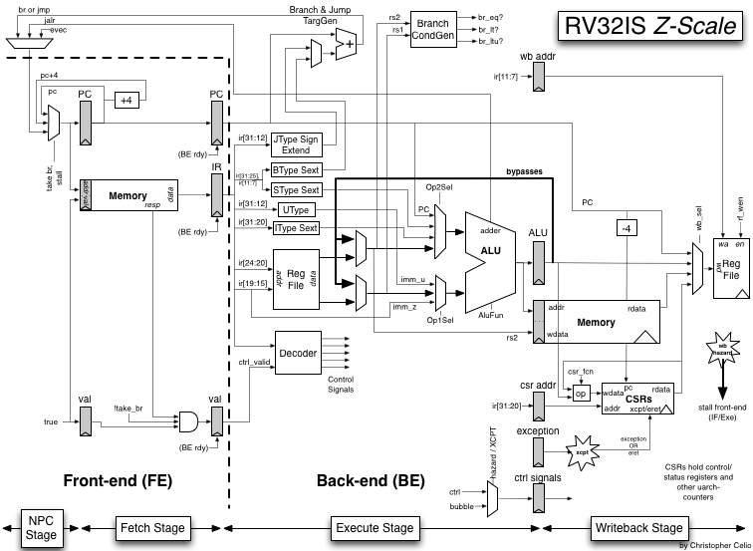
Generator Upgrades
Chisel 3.4, FIRRTL 1.4
Improved generated names
Improved verification APIs
Annotation handling improvements
Sodor Core Integration
Used for education and classes
Core integration documentation
Gemmini 0.5
GEMM Hardware FSM
Floating-point scaling
Transposer, im2col

Slide 22
Enabling Complete Open Source Agile SoC Design

Slide 23

Mixed Signal Roadmap
Initial exploration of mixed-signal block integration
BAG2 vs. BAG3 vs. BlackBox approaches
Majority of existing generators are in BAG2
Time-interleaved ADC, SerDes, PLLs, …
TSMC16, TSMC28, Intel22, GF14
BAG3-migration path
SKY130 (open source)
Intel22, GF12
PLL and ADC generators to be (re-)open-sourced

Slide 24
Open Source Community Support
Open-source EDA ecosystem tooling support
Skywater 130nm flow support for complete open-source
Generator-to-GSDII
OpenRoad integration as an open-source VLSI EDA flow
Hammer enables migration between the technologies

Slide 25
Conclusion

Slide 26
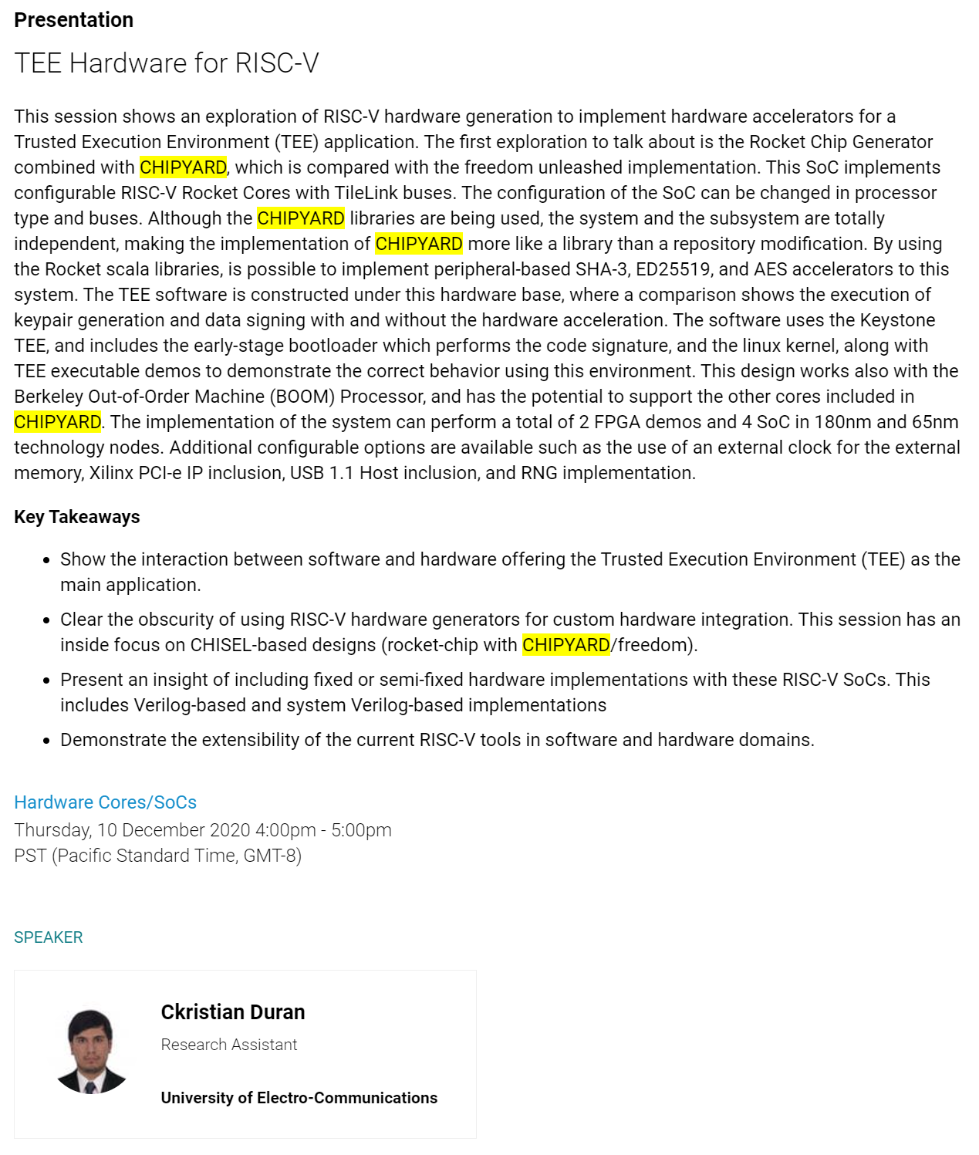
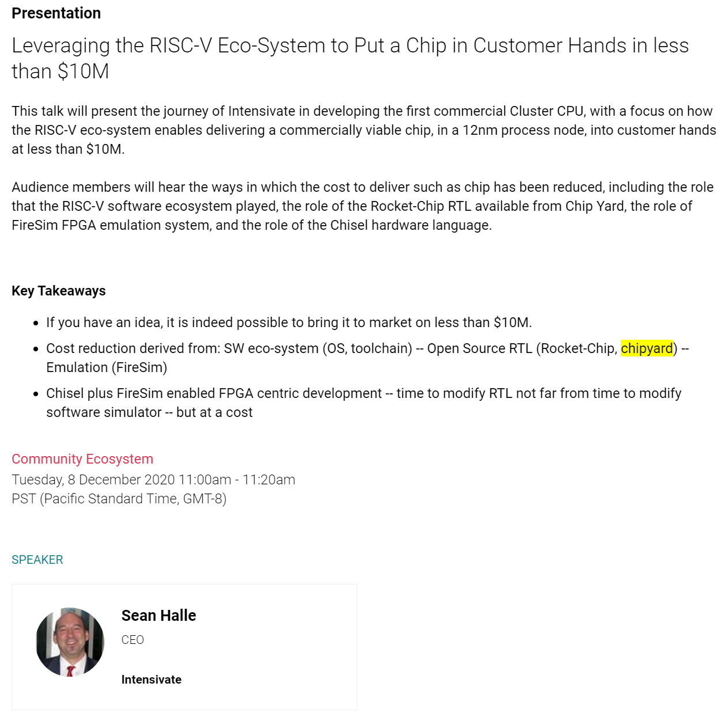
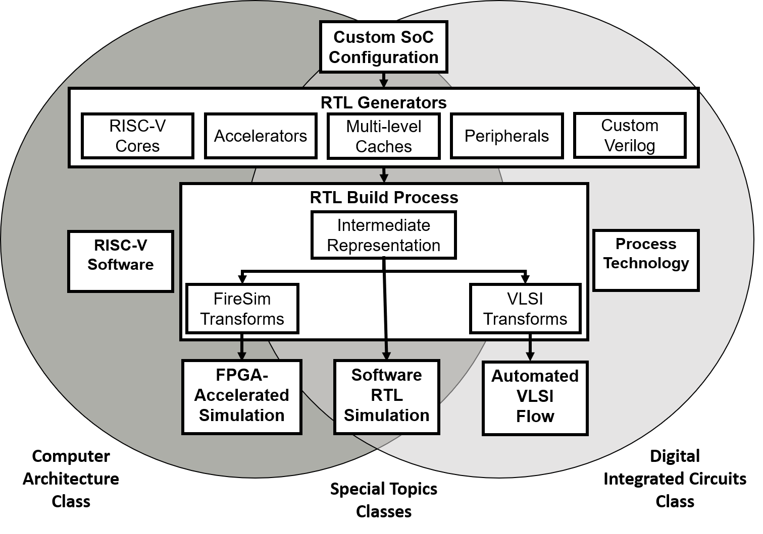
Community
RISC-V Summit talks using Chipyard
Education
Used (successfully) in 3 classes during Spring 2020
Used in 4 classes during Spring 2021
Notes:
External (RISC-V Summit talks)
Internal (Education)

Slide 27
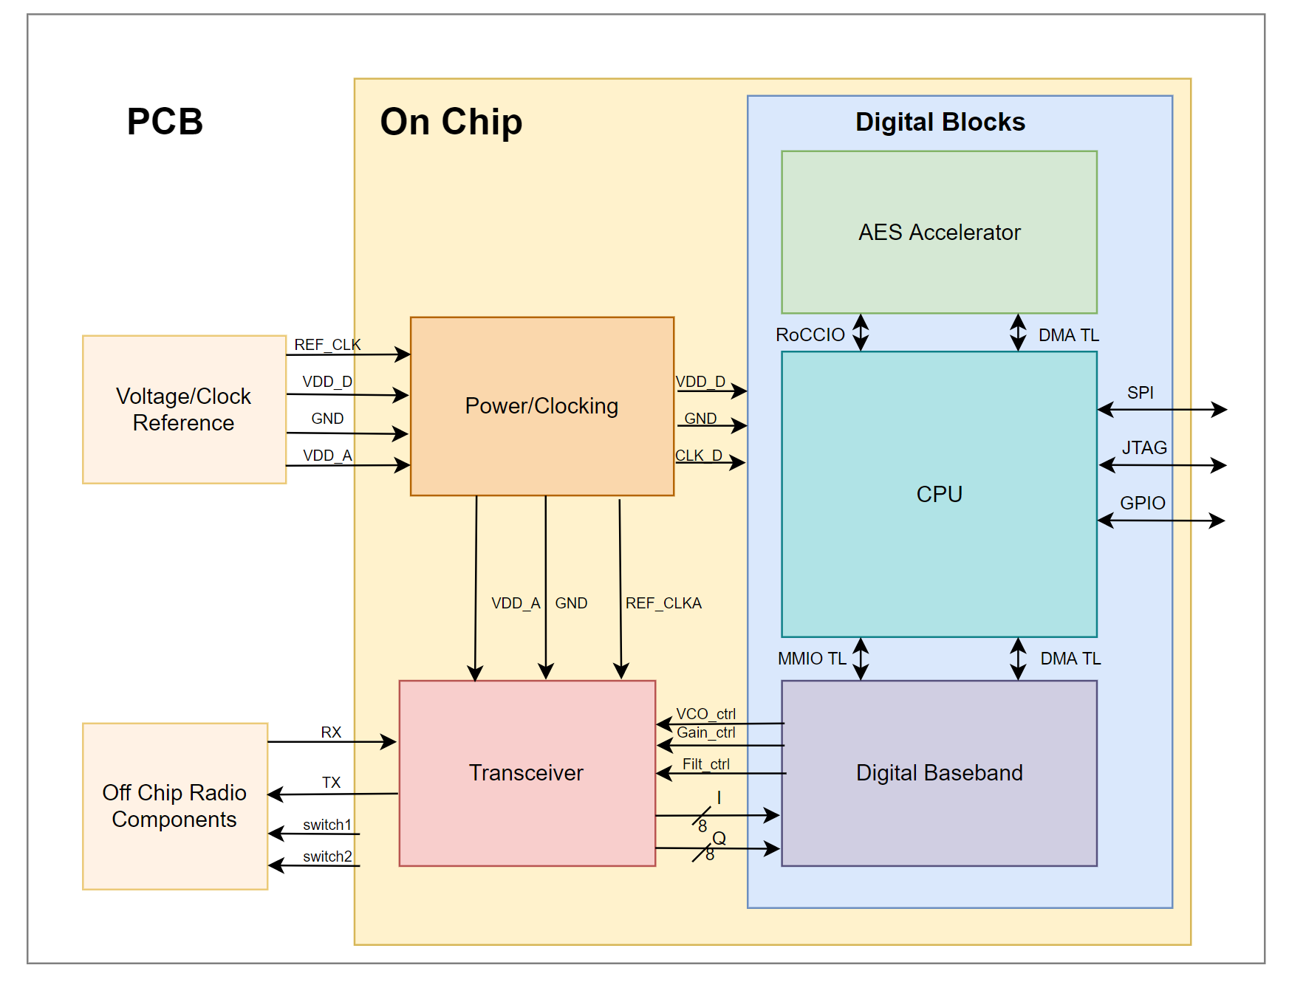


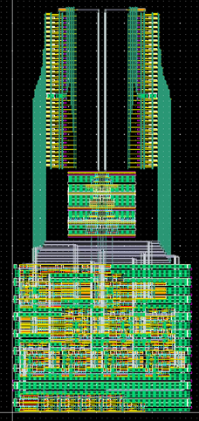
Berkeley EE192/290C Course
20 students designing a5th year M.S 28nm SOC: Rocket+AES+BLE 3rd-, 4th-yr undergrads,. students, first-year Ph.D.s and two more senior
No prior chip design experience!
https://github.com/ucb-bar/chipyard
Processor core, interfaces
Software tools
https://www.chisel-lang.org/
Custom BLE digital baseband, accelerator wrappers
Berkeley Analog Generator (BAG) - generated SAR ADC

Slide 28
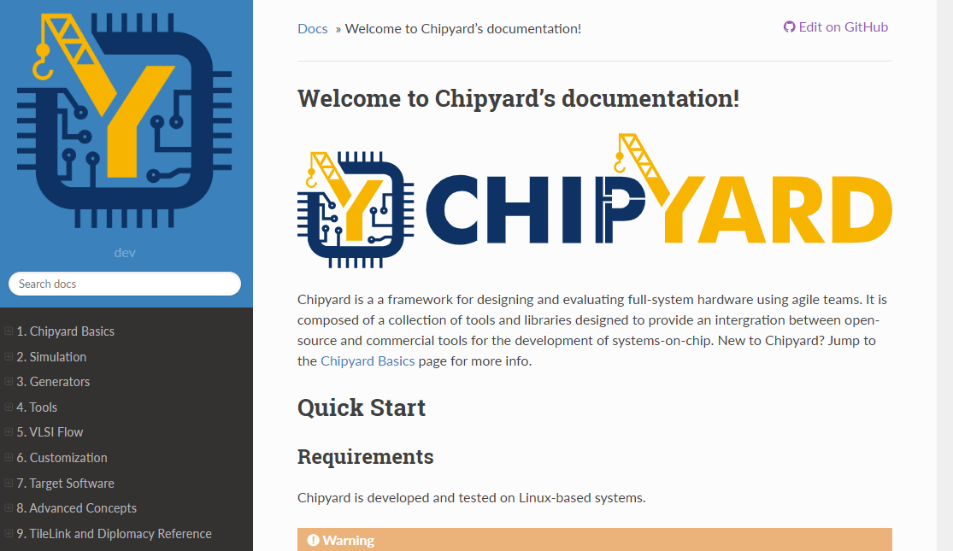
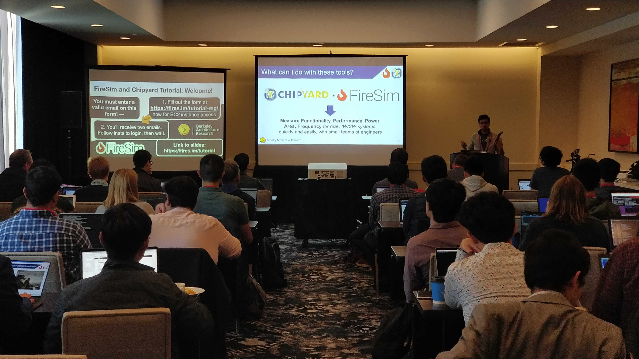
Community
Documentation
Over 100 pages!
chipyard.readthedocs.io
Talks about heterogeneous SoCs, adding Verilog IP, accelerators, etc.
Tutorials
MICRO 2019 Tutorial
RISC-V Summit 2019 Tutorial
(Almost) ASPLOS 2020 tutorial
ESSCIRC 2020 Tutorial
ISCA 2021 Tutorial
Mailing list
~200 threads

Slide 29

Summary
Chipyard 1.4 has been released
Github: https://github.com/ucb-bar/chipyard/
Docs: https://chipyard.readthedocs.io/en/latest/index.html
Mailing List: https://groups.google.com/forum/#!forum/chipyard
Integrated design, simulation and implementation framework
Roadmap to converging the various flows

Slide 30
Summary
We have made it easy to design specialized SoCs
Automated mapping into cloud FPGAs, ASICs
ASIC implementation requires access to proprietary tools and technologies
Open-source movement may enable easier-to-port ASIC tutorials
Skywater 130nm is an open-source PDK

Slide 31
Join The Community!
Used in industry and academia
Development is all open-source and on Github
Stable `master` branch (latest release)
Less-stable `dev` branch with all the newest features
Sub-projects managed using submodules
Over 100 pages of documentation!
If something isn’t clear, please let us know
We appreciate feedback! We appreciate PRs even more!

Slide 32


Learn More
Chipyard
Github: https://github.com/ucb-bar/chipyard/
Docs: https://chipyard.readthedocs.io/en/latest/index.html
Mailing List: https://groups.google.com/forum/#!forum/chipyard
FireSim
Website: https://fires.im/
Github: https://github.com/firesim/firesim/
Docs: https://docs.fires.im/en/latest/
Mailing List: https://groups.google.com/forum/#!forum/firesim

Slide 33
Acknowledgments
Faculty: K. Asanovic, E. Alon, J. Bachrach, V. Stojanovic, D. Patterson
Staff: B. Richards, C. Markley, J. Lawson, J. Dunn
Students (current and past): Brian Zimmer, Yunsup Lee, Ben Keller, Paul Rigge, Angie Wang, Stevo Bailey, Eric Chang, Pi-Feng Chiu, Colin Schmidt, John Wright, Martin Cochet, Albert Ou, Howard Mao, Woorham Bae, Jaeduk Han, Andrew Waterman, Henry Cook, Christopher Celio, Adam Izraelevitz, Zhongkai Wang, Sean Huang, Zhaokai Liu, Sagar Karandikar, Alon Amid, Nathan Narevsky, Jaehwa Kwak, Donggyu Kim, David Biancolin, Jack Koenig, Abraham Gonzalez, Ben Korpan, Jerry Zhao, Daniel Grubb, Harrison Liew,…
Intel Agile ISTC
DARPA CRAFT, PERFECT, RTML programs
STMicroelectronics, TSMC chip donations, fabrication

